Slide 1
CCMS Program National Call
March 25, 2020

Slide 2
Updates – Communicating during COVID-19
CBSA experiencing pressure to release people – expect increased referrals
Electronic monitoring?
Assessments can be done on the phone
Communicate by email using UCI only
Forms – no need for winzip if identifying information is removed (name, DOB)
Forms can be unsigned – email to confirm the information
Essential service

Slide 3
Per Diems
If you want to use per diem bed, a funding request must be submitted
For per diem only sites, if you assess a client and will not be accepting them, please submit a funding request for the value of the assessment
To a maximum of 4.5 hours at the rate of $41/hour, so not exceeding $184.50

Slide 4
Work Permit Applications

Slide 5
Work Permit
Print off work permit application for client to fill out, go over the information with the client ( I have attached a copy of the pdf work permit application as it is difficult to find online, I recommend saving it). I sometimes refer the client to another agency that has experts in filling these applications out as I don’t always have time to complete it with the client.
Have the client return with the application filled out to the best of their ability. Review application with the client. Some information may be left blank this is NORMAL!
Ensure names DOB and UCI are all correct as that information is vital.

Slide 6
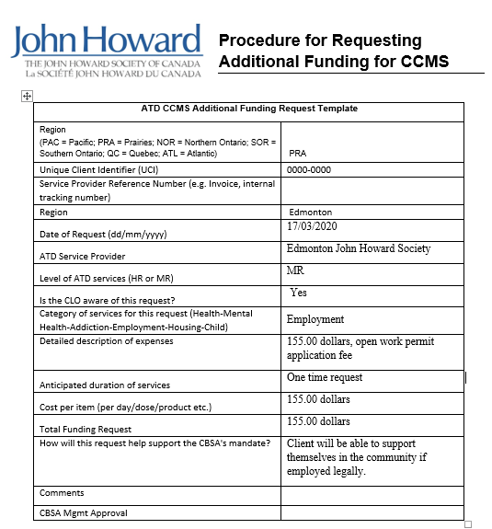
Fund Request
Prior to submitting the work permit application complete your JHS fund request. Remember to email it to Rhea and CC your CLO!
Here is an example!

Slide 7
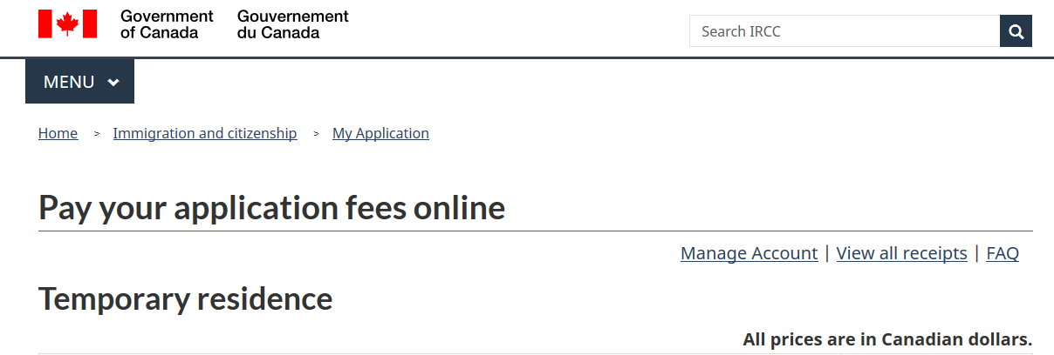
Payment of Work Permit
When request is approved complete online payment for the work permit with a John Howard Agency credit card. This is the link to the payment site https://eservices.cic.gc.ca/epay/order.do?category=17 you will select the following options Work permit (including extensions) – per person

Slide 8
Payment of Work Permit

Slide 9
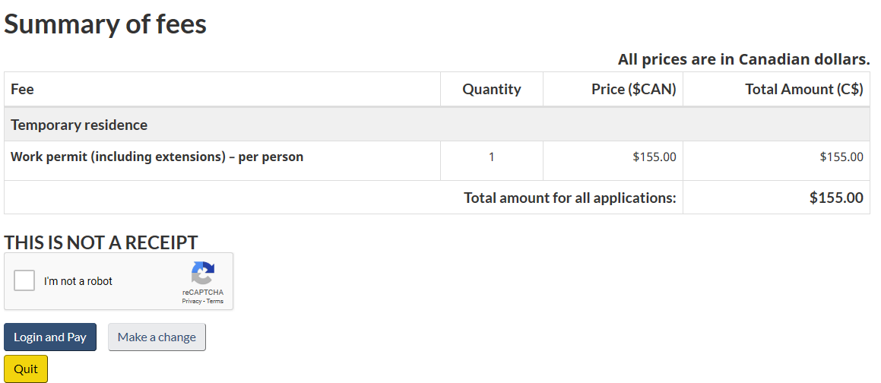
Payment of Work Permit
Once you click submit for the application you wish to pay for you will see this screen. Click login and pay! It will then re direct you to login or create an account.

Slide 10
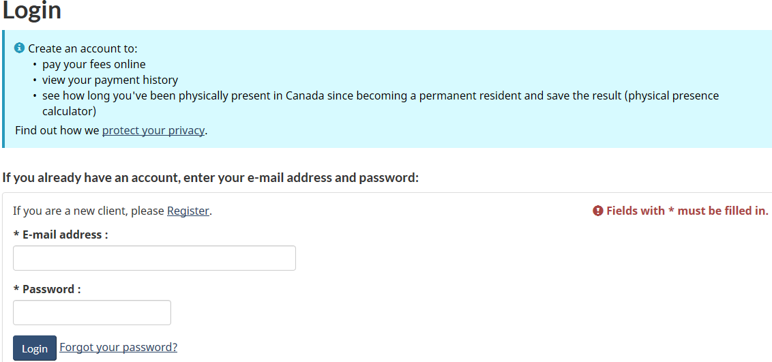
Payment of Work Permit and Creating Account
If this client does not have an account online with Government of Canada then click REGISTER!

Slide 11
Registration/Payment
Once you follow the prompts to register the client they will be sent an email verification code. Have the client provide the verification code to proceed with payment.
Once payment is complete you will need 3 copies of the receipt to print off. One for your supervisor to get reimbursed through Rhea, a second for your client file and a third copy to give to the client as it needs to be mailed with the work permit application.

Slide 12
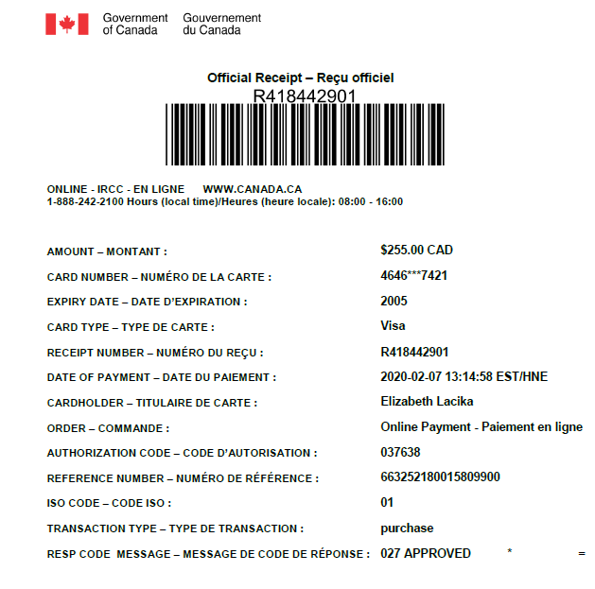

Slide 13
JHS Support Letter and Mailing
Complete the JHS work permit support letter that Rhea has sent out to us, this is key! If you do not attach this letter the work permit will not be expedited as it should be with our new procedures that CBSA and the IRB have created.
Lastly you or the client will mail the work permit off. Let your CLO know the day the application was mailed out. To find out where you send your applications check the link below and also double check with your CLO!
https://www.canada.ca/en/immigration-refugees-citizenship/corporate/contact-ircc/offices/case-processing-centre-edmonton-alberta.html

Slide 14
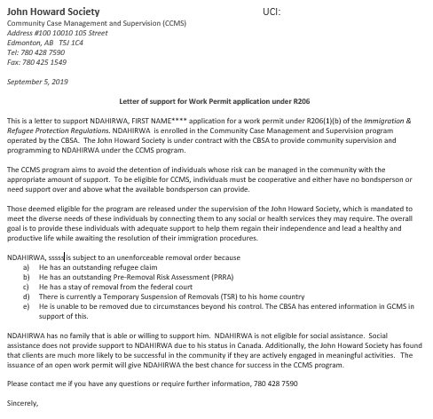

Slide 15
CAMS Tutorial
I will post something more formal on the portal in the next week or so including a sample complete file
Notes for now:
Please remember to close client files. Some files on system have been open over 300 days and haven’t had case notes in over 90. I assume this should be closed
Statistical questions – please try to answer all of them. Rate of completion ois less than 40%

